Slide 1
Employee Data Analysis using Excel
STUDENT NAME: ARCHANA K
REGISTER NO: DA048E1F5341BC4A30B4F0A91AB01427,312208645 DEPARTMENT: B.COM(GENERAL)
COLLEGE: MEENAKSHI COLLEGE FOR WOMEN

Slide 2
PROJECT TITLE
Employee Performance Analysis

Slide 3


AGENDA
Problem Statement
Project Overview
End Users
Our Solution and Proposition
Dataset Description
Modelling Approach
Results and Discussion
Conclusion
3/21/2024 Annual Review

Slide 4

PROBLEM
STATEMENT
The purpose of Employee performance analysis helps improve productivity, guide development, and align individual goals with organizational objectives.

Slide 5

PROJECT OVERVIEW
Employee performance analysis assesses work quality and productivity to align efforts with goals and guide development.

Slide 6

WHO ARE THE END USERS?
HUMAN RESOURCE MANAGEMENT
OPERATIONAL MANAGERS
FINANCIAL ANALYSTS
TEAM LEADERS AND SUPERVISORS
EMPLOYEES
SENIOR EXECUTIVES
COACHES AND MENTORS

Slide 7

OUR SOLUTION AND ITS VALUE PROPOSITION
FILTERING- REMOVE VALUES
PIVOT TABLE - SUMMARY OF EMPLOYEE PERFORMANCE
BAR DIAGRAM - FINAL REPORT

Slide 8
Dataset Description
EMPLOYEE DATA SET- KAGGLE
9 FEATURES IN EXCEL: EMPLOYEE ID- ALPHANUMERIC(TEXT) NAME- ALPHABETICAL(TEXT) GENDER- ALPHABETICAL(TEXT) DEPARTMENT - ALPHABETICAL(TEXT) SALARY - NUMERICAL
START DATE - ALPHANUMERIC(TEXT)
FTE- NUMERICAL
EMPLOYEE TYPE- ALPHABETICAL(TEXT)
EMPLOYEE LOCATION- ALPHABETICAL(TEXT)
3 FEATURES USED:
DEPARTMENT - ALPHABETICAL(TEXT)
FTE- NUMERICAL
EMPLOYEE TYPE- ALPHABETICAL(TEXT)

Slide 9

THE "WOW" IN OUR SOLUTION
Effective data visualization makes it easier to present complex data in an understandable way.
Well-presented data can have a significant impact on decision-makers, helping to drive change and innovation.
3/21/2024 Annual Re
view
9

Slide 10
MODELLING
STEP -1
DOWNLOAD THE EMPLOYEE DATASET AND OPEN THE EMPLOYEE DATASET IN EXCEL.
STEP -2
SELECT THE ENTIRE DATA AND CLICK ON DATA AND CLICK ON FILTER OPTION.
STEP -3
SORT FROM A TO Z ORDER.
STEP -4
SELECT THE ENTIRE DATA AND CLICK ON INSERT AND CLICK ON PIVOT TABLE TO CREATE PIVOT TABLE.
10

Slide 11
STEP -5
DRAG THE NEEDED DATA AND CREATE A PIVOT TABLE.
STEP -6
SELECT THE PIVOT TABLE AND CLICK ON INSERT.
STEP-7
NOW CLICK ON THE CHART THAT YOU WANT.
STEP -8
THE CHART IS CREATED.

Slide 12
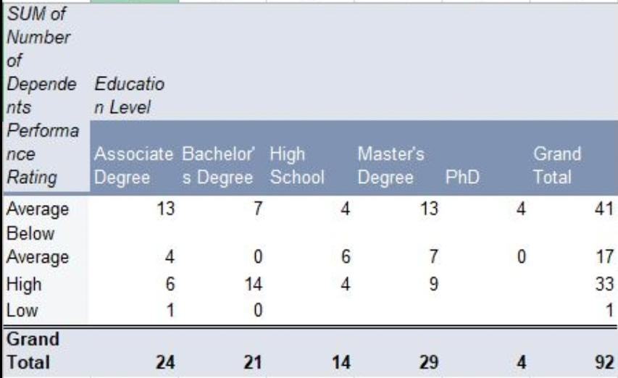
RESULTS
1.TABLE
12

Slide 13
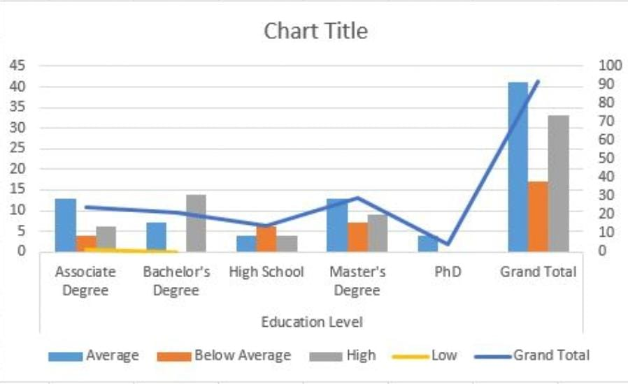
2. BAR DIAGRAM

Slide 14
conclusion
The dataset reveals the overall composition of the workforce, including demographics such as gender, salary, employee type and work location This information is crucial for understanding the diversity and experience level within the organization.
The analysis aids in workforce planning by forecasting future staffing needs based on current trends and organizational growth projections. This enables better preparation for scaling operations or restructuring the workforce.

